Slide 1

Twitter Hack
Sai Ajayakumar, Leoul Tadesse
Notes:
The cyber security incident we are going to talk about is the Twitter hack which happened mid - July

Slide 2
What happened?
On Wednesday, July 15, 2020 several high profile twitter accounts were hacked
The hackers gained Twitter’s administrative tools to post the tweets directly from the hacked accounts
The tweets asked individuals to send bitcoin currency to a specific cryptocurrency wallet saying they would double and return back the favor
Hacked accounts include: Elon Musk, Bill Gates, Joe Biden, Apple, Uber, etc
The hackers acquired about 400 payments in Bitcoin which equates to $121,000
Notes:
As you may have seen several twitter posts on 15th July from popluiarr accounts

Slide 3
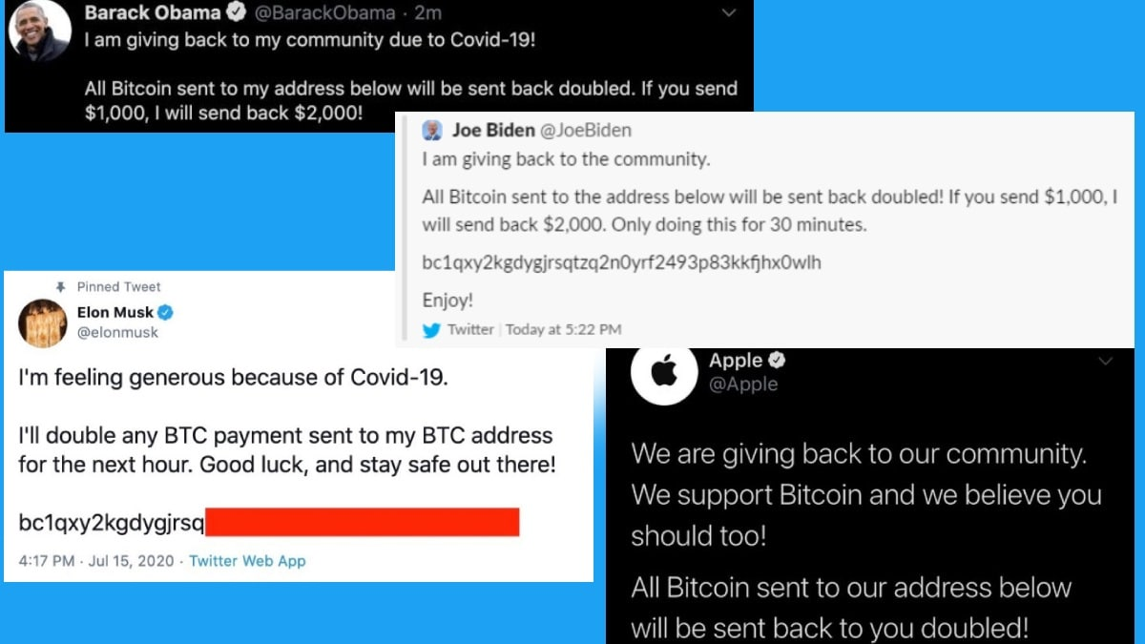

Slide 4
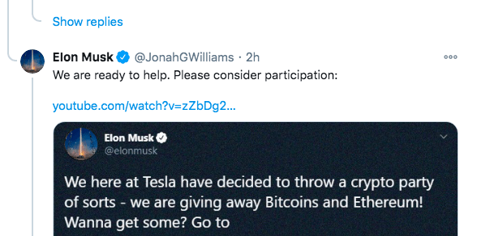
This type of scam is not new
In this picture, the scammer replies to a legit tweet which makes it very hard to know it’s a fake account.
Notes:
Older tweet. The fake accounts sometimes have even the checkmark. You wouldn’t know it’s fake until you click the account

Slide 5
Method of attack
Hackers got access to Twitter’s administrative tools
Hackers acquired the administrative tools through a compromised employee account
The hackers bypassed security measures such as two-factor authentication
The attackers got internal access by manipulating employees in order to get their credentials
Notes:
The hackers disclosed their method to media/Vice which is surprising and was a stunt

Slide 6
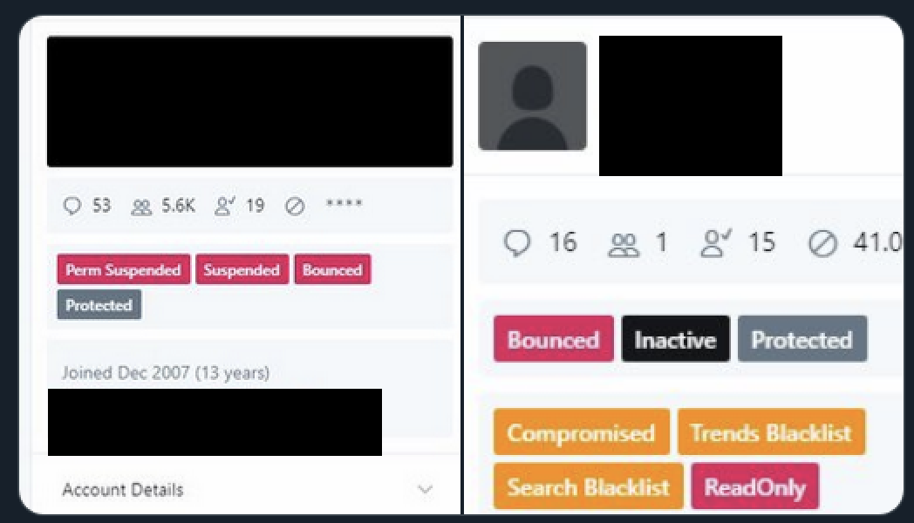
Twitter administrative tool
Notes:
With the tool, the hacker changed confirmation email of an account which let them reset the account password and gain access.

Slide 7
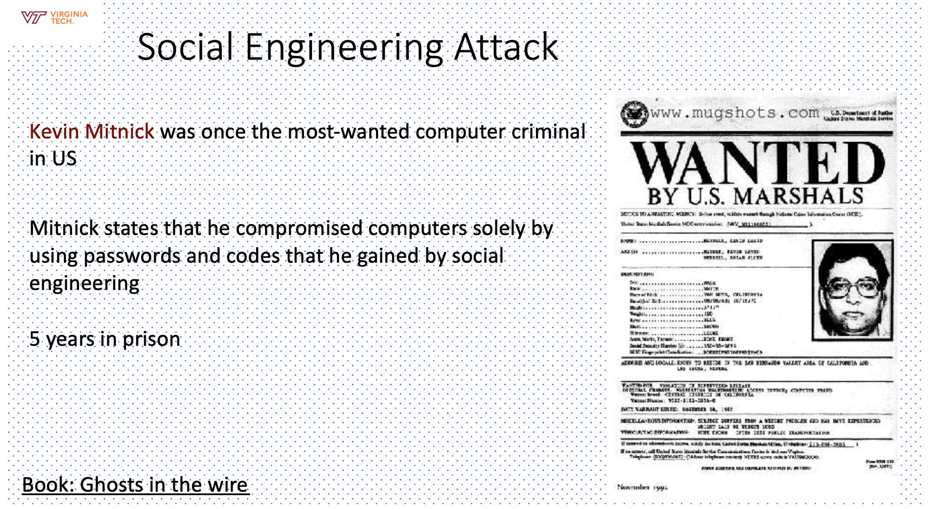
Connecting this incident to class topics
Similar to this slide, the hackers used “social engineering attack” to convince employees and get their credentials

Slide 8
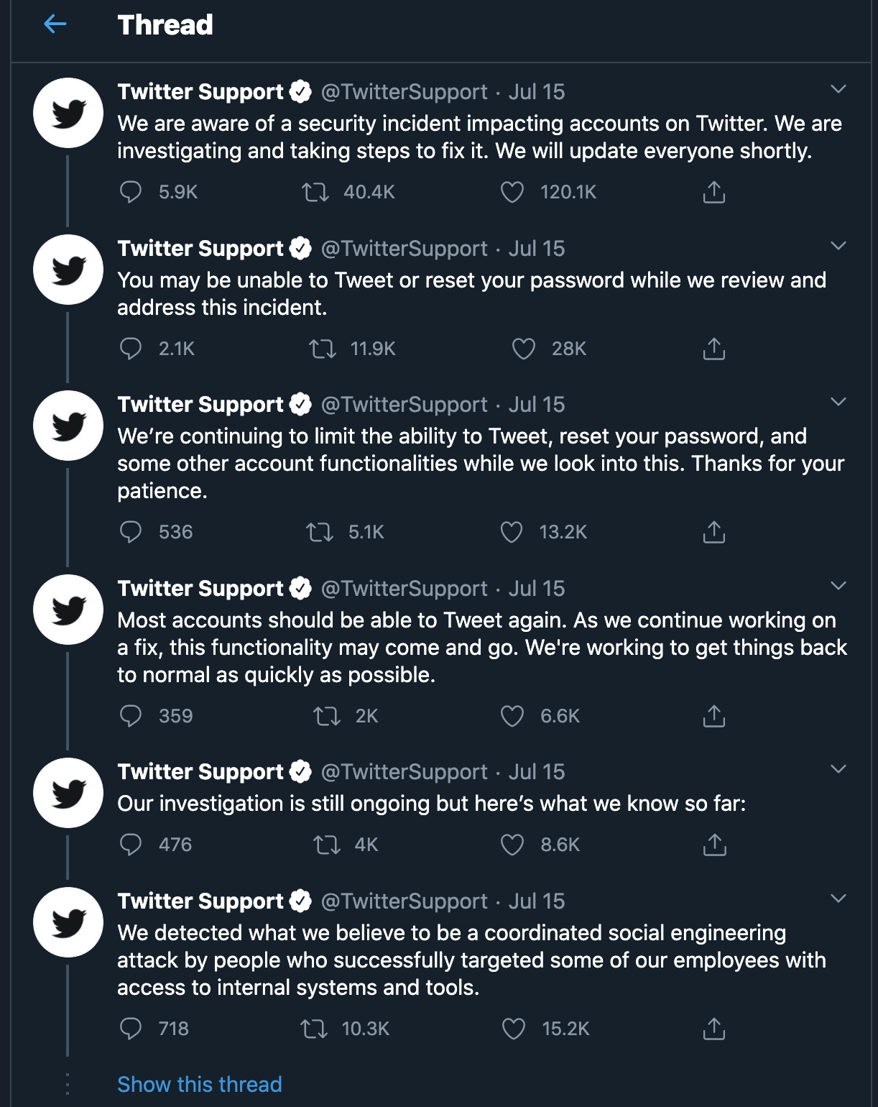
Social Engineering Attack

Slide 9
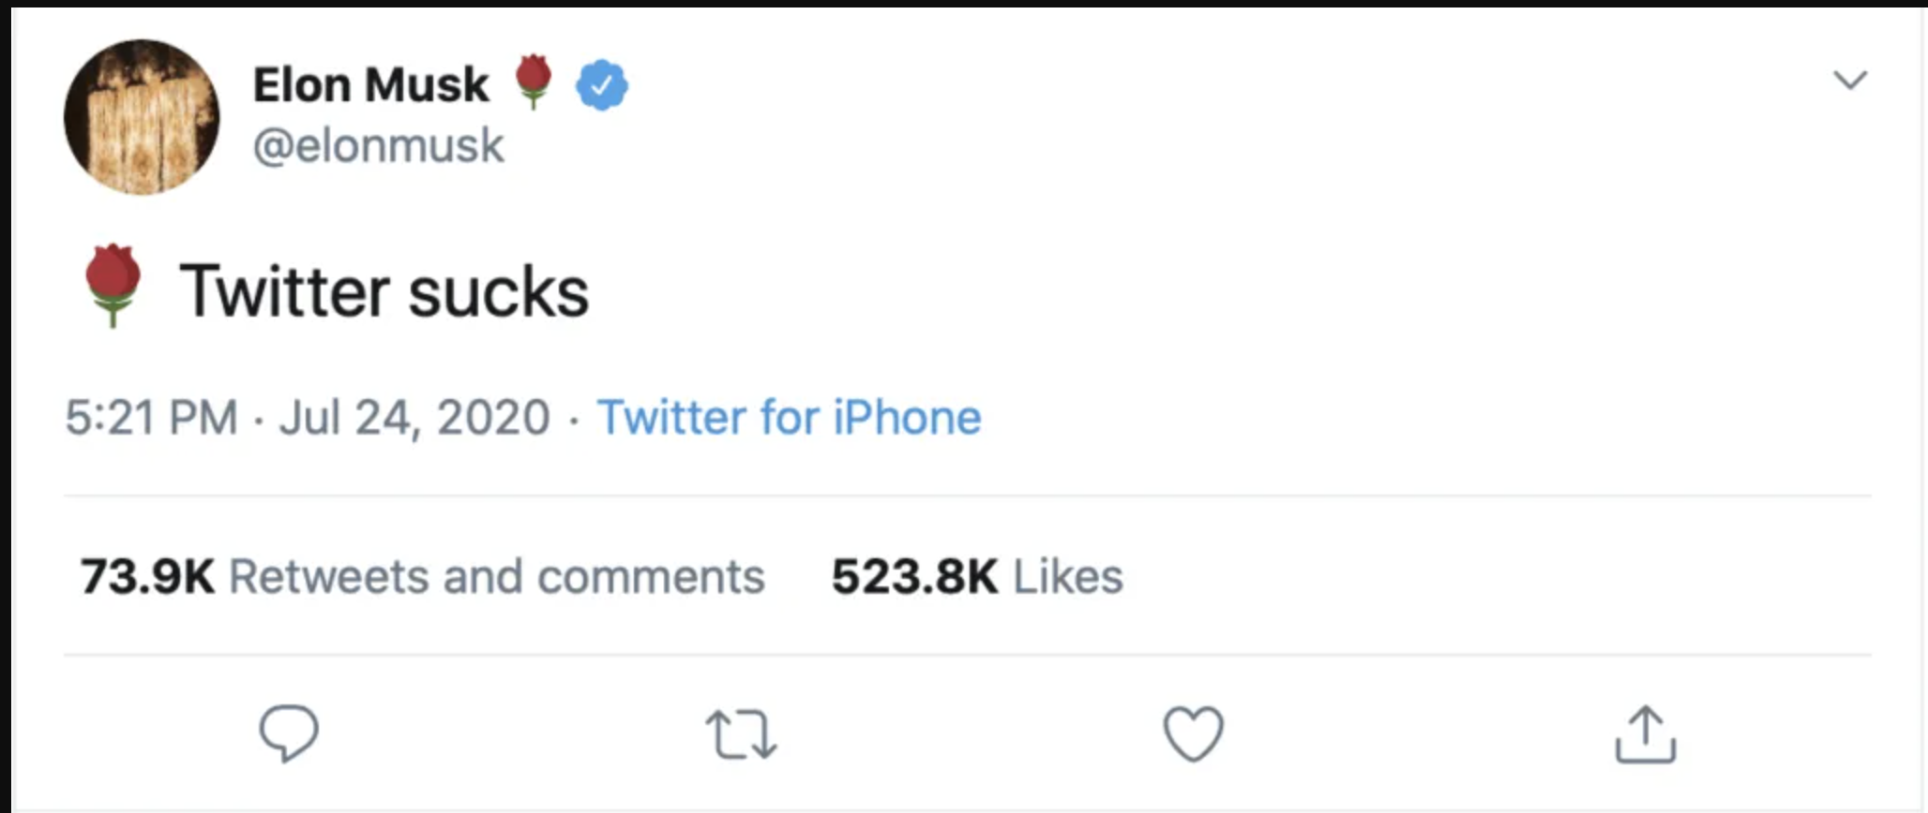
Outcomes
High profile accounts were locked and were not able to tweet
Twitter credibility is damaged

Slide 10
Connecting this incident to class topics
Paradox
Allow valid accounts tweet
Prevent hackers from accessing or impersonating accounts

Slide 11
Sources
“2020 Twitter Bitcoin Scam.” Wikipedia, Wikimedia Foundation, 25 Sept. 2020, en.wikipedia.org/wiki/2020_Twitter_bitcoin_scam.
“Who's Behind Wednesday's Epic Twitter Hack?” Brian Krebs, krebsonsecurity.com/2020/07/whos-behind-wednesdays-epic-twitter-hack/.
Kifleswing. “Twitter Hackers Who Targeted Elon Musk and Others Received $121,000 in Bitcoin, Analysis Shows.” CNBC, CNBC, 16 July 2020, www.cnbc.com/2020/07/16/twitter-hackers-made-121000-in-bitcoin-analysis-shows.html.

